Slide 1
Medi-Cal Renewals: Ensuring People Experiencing Homelessness Retain Coverage

Slide 2
What is at Stake?
Medi-Cal enrollees MUST renew their coverage annually.
Renewal* = county determines whether a member is still eligible.
After a 3-year pause, the renewal process restarted in CA as of June 2023.
2-3 million will lose coverage in CA throughout the year-long process, including ~1.5 million who are still eligible.
People experiencing homelessness are especially at risk of losing coverage!
Why? Renewal notices will be sent to last known addresses.
*Note: redetermination, recertification, renewal are all used interchangeably.

Slide 3
Next Steps
Help people that are currently experiencing homelessness or have experienced homelessness in the past three years:
Update contact information
Get a mailing address to share with Medi-Cal
Create a Medi-Cal account online
Call or visit the county Medi-Cal office to renew directly (might be long wait times)

Slide 4
Seek Assistance
Key Contacts
Fresno County Dept. of Social Services
call (559) 600-1377
multiple locations
Madera County Dept. of Social Services
call (559) 675-2300
1620 Sunrise Ave, Madera, CA 93638
Health Enrollment Navigators
contact navigators for free assistance
Go online to apply or renew @ KeepMediCalCoverage.com
Notes:
Local DHCS offices: https://www.dhcs.ca.gov/services/medi-cal/Pages/CountyOffices3.aspx [make specific to County]
Health enrollment navigators: https://www.dhcs.ca.gov/services/medi-cal/eligibility/Documents/SB154-Subcontractor-and-Local-CBO-Assistance.pdf
KeepMediCalCoverage.com.

Slide 5
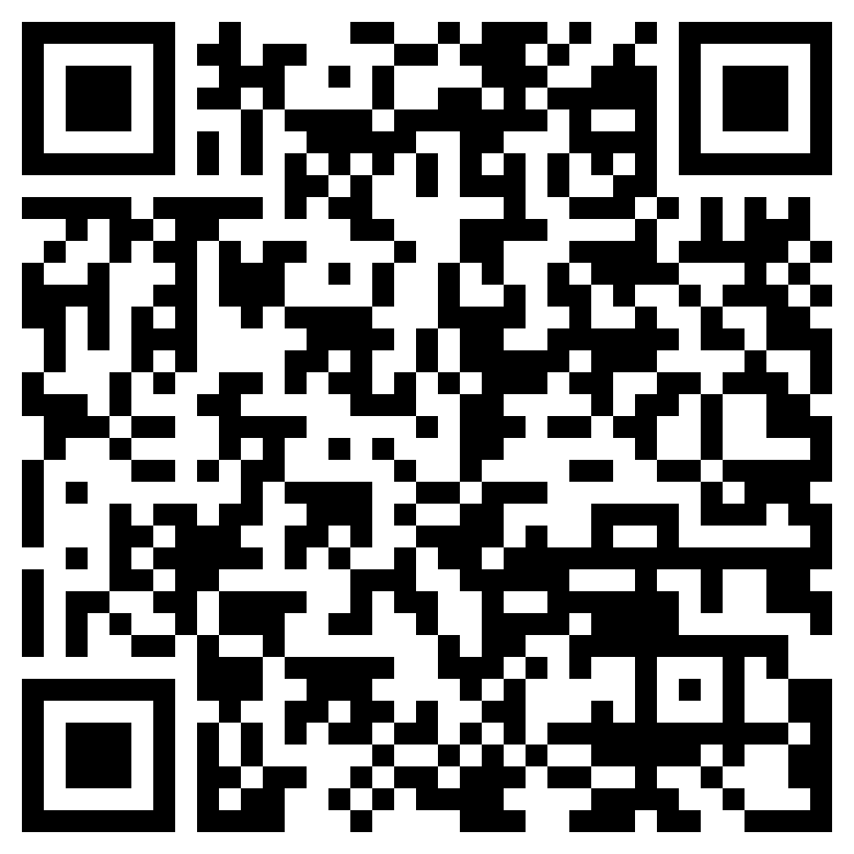
Help Spread the Word
Share Homebase and DHCS tools within your communities
Contact Homebase with any questions at Medi-Cal@homebaseccc.org
Tell us your stories!
Learn more about how to help your community at Homebase’s state-wide Medi-Cal Renewal webinar on October 3 from 12:30-2:00 PM
Register Here!
Notes:
If you have any questions, please contact Medi-Cal@homebaseccc.org.
Register link: https://homebaseccc.zoom.us/meeting/register/tZAqfuqpqD0qGdW1h_5MkEy3NWPyfzT2FdHH#/registration

